Slide 1
Chapter 7: The body can protect itself from infection

Slide 2
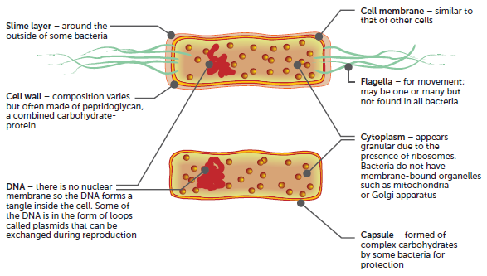
7.1 Pathogens
The most common pathogens that affect the human body are bacteria and viruses, although fungi and animal parasites can also be involved. This chapter focuses on bacteria and viruses.
Bacteria
Bacteria are prokaryote, unicellular organisms with a simple internal structure. They lack a nucleus; their DNA either floats freely in the cytoplasm or is in the form of circular plasmids.

Slide 3
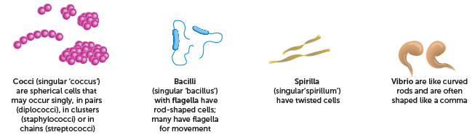
7.1 Pathogens
The great majority of bacteria are harmless to humans; they are non-pathogenic. Many bacteria are essential to life on Earth, through their role in the decomposition of organic material and the cycling of the elements. Some bacteria are used in industrial processes.
Huge numbers of bacteria live on our skin, in our alimentary canal and in other parts of the body. Bacteria affect the body differently, depending on the species. Effects may include producing toxins or inducing an allergic response.
Types of bacteria, classified according to cell shape

Slide 4
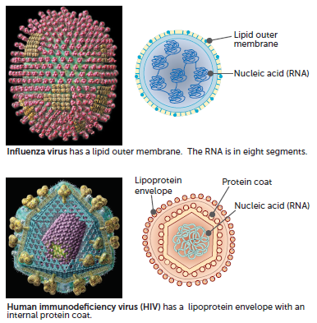
7.1 Pathogens
Viruses
Some diseases are caused by viruses. Viruses contain genetic material in the form of a molecule of either DNA or RNA, but they never contain both. The molecule of DNA or RNA is surrounded by a coat of protein. Some viruses also have an external lipid envelope.

Slide 5
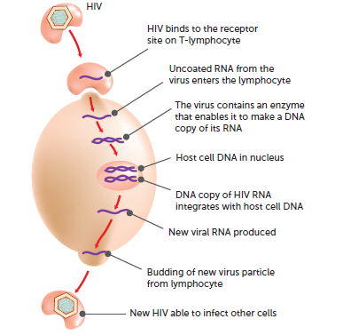
7.1 Pathogens
Viruses are not living things, as they cannot reproduce by themselves. Instead, they infect a living cell and its DNA or RNA induces the cell to manufacture more virus particles. The new virus particles are then able to leave the host cell to infect others. During this process the cells become damaged or changed, or die. Viruses differ in the type of cell they invade; therefore, the symptoms shown relate to the tissue that is affected. Some viruses multiply in bacterial cells, causing the death of the bacterium, known as bacteriophages.

Slide 6
7.1 Pathogens
Transmission of pathogens
Communicable disease may be spread by the transmission of the pathogenic organism from one person to another. Some communicable diseases are said to be contagious; this means they are passed directly from one person to another. Other communicable diseases may be spread from person to person by vectors; intermediate hosts of the pathogen, such as mosquitoes or fleas.
Types of transfer:
Transmission by physical contact
Ingestion of contaminated food or drink
Transfer of infected body fluids
Infection by droplets
Airborne transmission
Transmission by vectors (other animals)

Slide 7
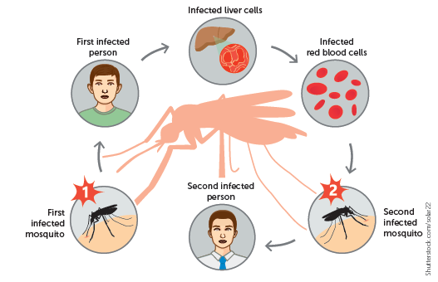
7.1 Pathogens
Shutterstock.com/solar22
Transmission of malaria via a mosquito vector

Slide 8
7.2 Non-specific defences against disease
Our bodies have several defences that protect us against invasion by pathogenic micro-organisms. Non-specific defences work against all pathogens. They are the body’s first line of defence. Specific defences are directed at a particular pathogen.
External defences
The body’s external defences include:
Skin
Mucus
Hairs
Cilia
Acids
Lysozyme
Cerumen
Movement of fluid

Slide 9
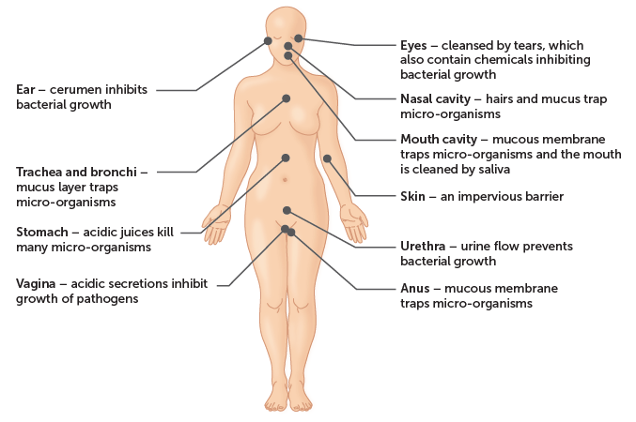
7.2 Non-specific defences against disease

Slide 10
7.2 Non-specific defences against disease
Protective reflexes
A reflex is an automatic, involuntary response to a stimulus. Four reflexes help to protect against infection by removing foreign particles.
Sneezing
Coughing
Vomiting
Diarrhoea

Slide 11
7.2 Non-specific defences against disease
Internal non-specific defences
If pathogens get past our external defences, there are internal non-specific defences that work to eliminate them.
Phagocytosis
Organisms that penetrate our external defences are attacked by phagocytes. Phagocytes are specialised white blood cells, or leucocytes, that engulf and digest micro-organisms and cell debris. This eliminates many pathogens before an infection has a chance to take hold.
There are a number of different types of cells that are phagocytic.
Monocytes and macrophages
Neutrophils
Dendritic cells

Slide 12
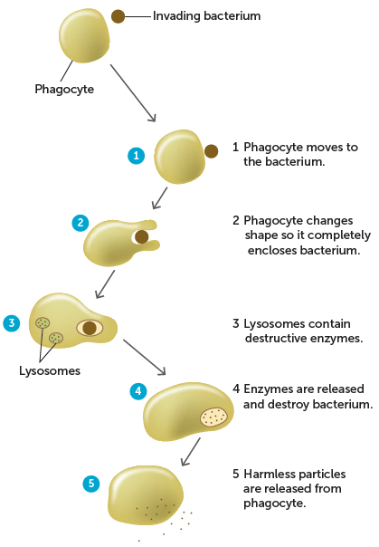
7.2 Non-specific defences against disease
Process of phagocytosis

Slide 13
7.2 Non-specific defences against disease
Inflammatory response
Words ending in -itis indicate inflammation of specific organs or tissues. For example, tonsillitis is inflammation of the tonsils.
Inflammation is a response to any damage to the tissues. The purpose of inflammation is to:
reduce the spread of any pathogens, to destroy them and to prevent the entry of additional pathogens
remove damaged tissue and cell debris
begin repair of the damaged tissue.
There are four signs of inflammation: redness, swelling, heat and pain.

Slide 14
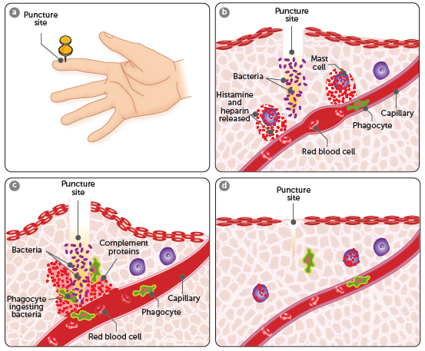
7.2 Non-specific defences against disease
Damage to tissues stimulates a series of steps in the inflammatory response. Some of these steps are assisted by proteins in the complement system that are produced by liver cells and macrophages.
a When the skin is broken, a non-specific inflammatory response is triggered. b Mast cells release histamine and heparin. Histamine diffuses into capillaries, causing them to dilate and become leaky. The area becomes red and swollen. Heparin prevents clotting in the immediate area. c Complement proteins are activated and, along with chemicals from the mast cells, attract phagocytes to the area, which engulf and digest dead cells and bacteria. d The tissue heals when histamine and protein signalling finish and phagocytes are no longer attracted to the area

Slide 15
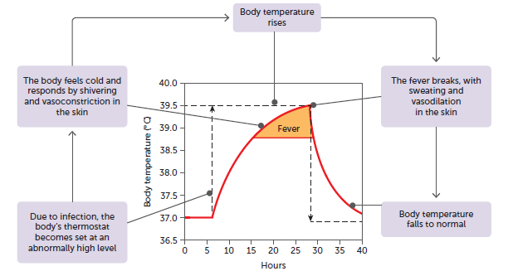
7.2 Non-specific defences against disease
Fever
An infection such as the common cold or influenza is frequently accompanied by an elevation of body temperature, often called a fever. Fever occurs when the body’s set point for temperature is increased due to pyrogens acting on the hypothalamus. Fever can help fight infections but is dangerous if it goes too high.
Body temperature during a fever

Slide 16
7.2 Non-specific defences against disease
Lymphatic system
The lymphatic system consists of:
• a network of lymph capillaries joined to larger lymph vessels
• lymph nodes, which are located along the length of some lymph vessels.
It is an important part of the body’s internal defence against pathogenic organisms.
Lymph entering the lymph nodes contains cell debris, foreign particles and micro-organisms that have penetrated the body’s external defences. Some of these micro-organisms may be pathogenic and, if not destroyed, could cause disease.
Larger particles, such as bacteria, are trapped in the meshwork of fibres as the lymph flows through the spaces in the nodes. Macrophages ingest and destroy these particles by phagocytosis.
When infections occur, the formation of lymphocytes increases, and the lymph nodes become swollen and sore.

Slide 17
7.3 Specific defences against disease
Specific defences are those directed towards a particular pathogen. Specific defences are part of our immune system. The immune system is composed of cells and proteins that protect against foreign organisms, a range of alien chemicals, as well as cancerous and other abnormal cells. Some of these cells are non-specific, such as phagocytes, which are able to engulf and digest micro-organisms and cell debris. However, others such as B-cells and T-cells only provide protection against a specific micro-organism or disease-causing substance. When these cells react, it is called the immune response.
Immune response
The immune response is a homeostatic mechanism. When micro-organisms or foreign substances enter the body, the immune response helps to deal with the invasion and restore the internal environment to its normal condition.
The key cells involved in the immune response are B-cells and T-cells, which are white blood cells called lymphocytes. B-cells and T-cells are both produced in the bone marrow and end up in the lymphoid tissue.

Slide 18
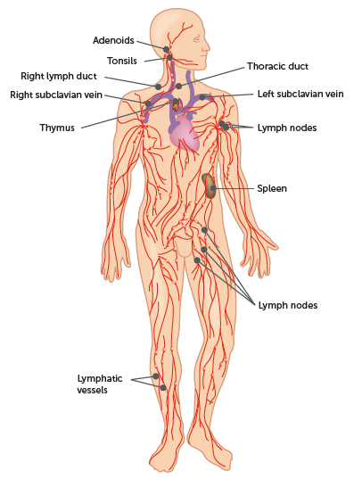
7.3 Specific defences against disease
Most of the lymphoid tissue is in the lymph nodes; however, it also occurs in other parts of the body.

Slide 19
7.3 Specific defences against disease
There are two parts to the immune response.
The humoral response or antibody-mediated immunity involves the production of special proteins called antibodies by B-cells, which circulate around the body and attack invading agents.
The cell-mediated response is due to T-cells and involves the formation of special lymphocytes that destroy invading agents.

Slide 20
7.3 Specific defences against disease
Antigens
Antibody-mediated and cell-mediated immunity are both triggered by antigens. An antigen is any substance capable of causing a specific immune response. They are large molecules such as proteins, carbohydrates, lipids or nucleic acids, and may include:
virus particles
whole micro-organisms
part of a bacterium
toxins, and others.
Large molecules produced in a person’s own body do not cause an immune response. These are called self-antigens. Foreign compounds that do trigger an immune response are non-self antigens.
The immune system becomes programmed before birth to distinguish between self-antigens and non-self antigens. From then on, it only attacks non-self antigens.

Slide 21
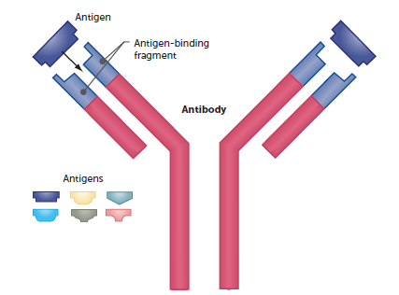
7.3 Specific defences against disease
Antibodies
An antibody is a Y-shaped specialised protein that is produced by plasma cells in response to a non-self antigen. Antibodies belong to a group of proteins known as immunoglobulins, often represented as ‘Ig’. There are five classes of antibodies, which vary in their structure and are designated IgA, IgD, IgE, IgG and IgM.
The antibody produced in response to an antigen can combine with that antigen to form an antigen–antibody complex. Antigen molecules have specific active sites with a particular shape. The antibody has the complementary shape, allowing the two molecules to fit together like a key in a lock. Each antibody can combine with only one particular antigen.

Slide 22
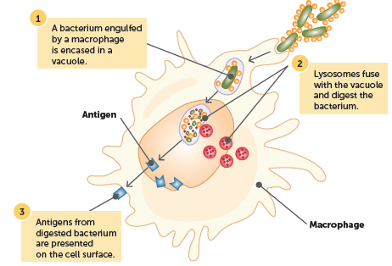
7.3 Specific defences against disease
Antigen-presenting cells
When a non-self antigen enters a body, specific cells recognise this and respond appropriately. These cells are called antigen-presenting cells, and include dendritic cells, macrophages and undifferentiated B-cells. These cells:
• detect the presence of a non-self antigen
• engulf the pathogen
• digest the pathogen, producing small fragments that move to the surface of the cell
• present the antigen to lymphocytes.
Antigen-presenting cells, such as macrophages, detect, engulf and digest pathogens to present the antigens to lymphocytes

Slide 23
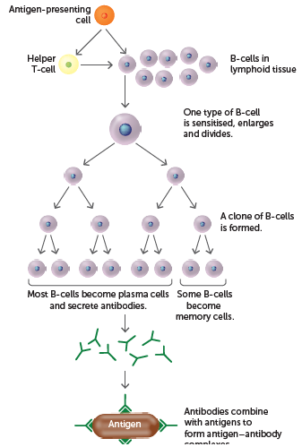
7.3 Specific defences against disease
Antibody-mediated immunity
The humoral response involves the production and release of antibodies into the blood and lymph. This is antibody-mediated immunity. It provides resistance to viruses, bacteria and bacterial toxins before these micro-organisms or substances enter the body’s cells.
Events in the antibody-mediated immune response

Slide 24
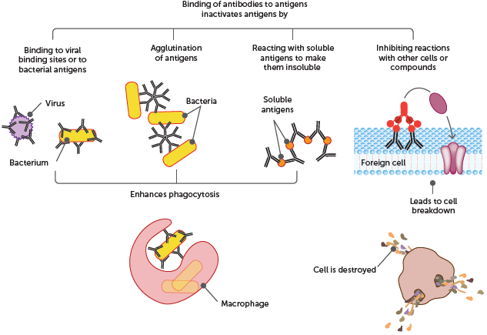
7.3 Specific defences against disease
How antibodies work
Different antibodies protect the body by different methods. The diagram summarises the action of antibodies.

Slide 25
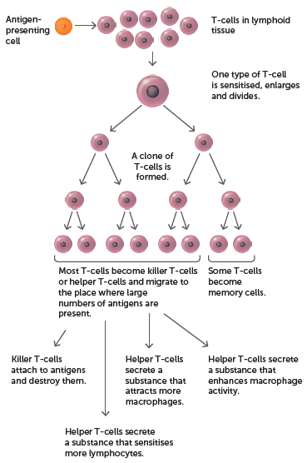
7.3 Specific defences against disease
Cell-mediated immunity
Cell-mediated immunity provides resistance to the intracellular phase of bacterial and viral infections. It is also important in ‘fighting’ whole cells, such as providing resistance to fungi and parasites, and in rejecting foreign-tissue transplants.
Cell-mediated immunity occurs when T-cells are stimulated, resulting in the production of killer T-cells and helper T-cells as well as memory cells.
Response to T-cells in cell-mediated immunity

Slide 26
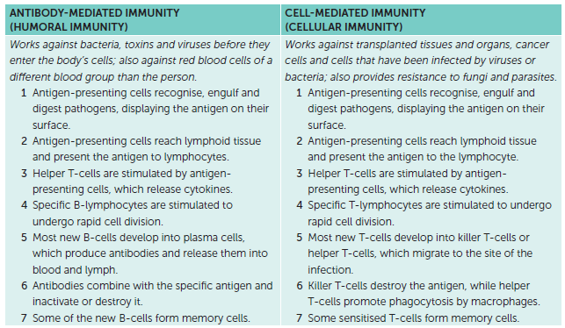
7.3 Specific defences against disease
Summary of immune responses

Slide 27
7.3 Specific defences against disease
Types of immunity
Immunity is resistance to infection by invading micro-organisms. The presence of memory cells allows the body to respond quickly enough to deal with any invasion by pathogenic micro-organisms before symptoms of disease occur. The ability to respond rapidly may be natural or artificial. Natural immunity occurs without any human intervention; artificial immunity results from giving people an antibody or antigen.
Natural and artificial immunity can be passive or active.

Slide 28
7.3 Specific defences against disease
Passive immunity
Passive immunity is when a person receives antibodies produced by someone else, meaning that the individual’s body plays no part in the production of antibodies. This can occur naturally when antibodies from the mother pass across the placenta to a developing foetus or when the mother’s antibodies are passed to the baby in breast milk. It can also be gained artificially when a person is injected with antibodies to combat a particular infection. This is often done when a person is exposed to pathogens that cause serious diseases, such as tetanus, diphtheria and rabies. Antibodies are given so that immunity is established immediately. Passive immunity is short-lived: it lasts only until the antibodies are broken down and excreted.

Slide 29
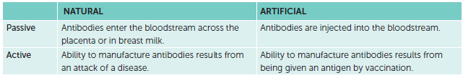
7.3 Specific defences against disease
Active immunity
Active immunity results when the body is exposed to a foreign antigen and manufactures antibodies in response to that antigen. While the amount of antibody decreases, this type of immunity lasts longer than passive immunity due to the presence of memory cells. Should a subsequent infection involving the same antigen occur, the appropriate antibodies can be produced very quickly, eliminating the antigen before the infection can produce any disease symptoms. Active immunity to a disease can develop from having the disease and recovering (natural active immunity) or from an injection of the antigens associated with the disease (artificial active immunity).

Slide 30
7.4 Prevention and treatment of disease
Vaccines
Immunisation means programming the immune system so that the body can respond rapidly to infecting micro-organisms, i.e. developing an immunity. This can occur naturally or artificially. Vaccination is the artificial introduction of antigens of pathogenic organisms so that the ability to produce the appropriate antibodies is acquired without the person having to suffer the disease.
A vaccine is the antigen preparation used in artificial immunisation. There are four types of traditional vaccines:
Live attenuated vaccines
Inactivated vaccines
Toxoid vaccines
Sub-unit vaccines.
Scientists are constantly investigating alternative methods of immunisation that are more effective with fewer side effects.

Slide 31
7.4 Prevention and treatment of disease
Vaccine delivery
The most common method of vaccination is to inject the vaccine using a syringe, but other forms of delivery can be used. One type of polio vaccine is given by mouth in a sweet syrup or in lumps of sugar (no longer used in Australia). Other forms of delivery are currently under research, including a fine spray, skin patches and ingestion in food.
Vaccination schedule
Most vaccinations do not start until a child is two months old, and for most diseases more than one vaccination is necessary. Vaccination should not start too soon after birth, as the child’s blood contains antibodies from its mother via the placenta or in breast milk. If a newborn is given a vaccine, the antibodies from the mother eliminate the antigens in the vaccine. This occurs before the child’s immune system can mount an immune response.

Slide 32
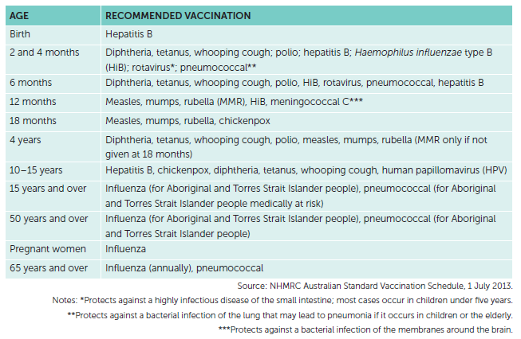
7.4 Prevention and treatment of disease
Recommended vaccination schedule for Australians

Slide 33
7.4 Prevention and treatment of disease
Vaccination of populations
The use of vaccines in mass immunisation programs has either eradicated or greatly reduced the incidence of certain diseases throughout the world, e.g. smallpox.
Other vaccination programs are on a smaller scale and are frequently used to prevent the possibility of a serious outbreak of a highly infectious disease, e.g. influenza virus. These vaccination programs not only reduce the chance of disease in the most susceptible individuals but also increase the immunity of the population, known as herd immunity. Herd immunity depends on a high proportion of individuals being immunised. When there are a large number of immune individuals in a population, there is less chance of the disease being transmitted between them.
The proportion of the population that needs to be immune to protect the population varies between diseases.

Slide 34
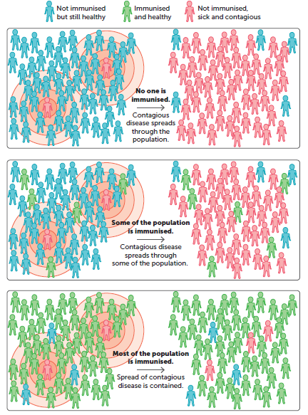
7.4 Prevention and treatment of disease
Herd immunity

Slide 35
7.4 Prevention and treatment of disease
Factors to consider with vaccinations
Various factors may affect a person’s viewpoint on vaccines.
Inability to be vaccinated due to health issues
allergic reactions
preservatives
Social factors
ethical concerns with the use of animals to produce vaccines
ethical concerns with the use of human tissue to produce vaccines
ethical concerns with informed consent
ethical concerns with testing on animals
concerns about promoting sexual activity in teenagers
availability

Slide 36
7.4 Prevention and treatment of disease
Cultural factors
religious beliefs
Economic factors
cost of vaccine
commercialisation.
In all issues relating to vaccines, individuals must be guided by their own beliefs and values. However, before making a decision about vaccination, it is the responsibility of each of us to ensure we are fully informed about all the possible consequences of the decision.

Slide 37
7.4 Prevention and treatment of disease
Antibiotics
Antibiotics are drugs that are used to fight infections of micro-organisms, particularly bacteria. They cannot be used to treat viral infections. Each antibiotic is effective for only certain types of bacterial infection, and testing is often carried out prior to antibiotics being prescribed.
There are two types of antibiotics. Bactericidal antibiotics kill bacteria by changing the structure of the cell wall or cell membrane, or by disrupting the action of essential enzymes. Bacteriostatic antibiotics stop bacteria from reproducing, usually by disrupting protein synthesis. Both types are effective in treating bacterial infections.
Some antibiotics affect a wide range of different types of bacteria. These are broad-spectrum antibiotics. Others, narrow-spectrum antibiotics, are effective only against specific types of bacteria.
Some of the bacteria that antibiotics are used to kill have gradually evolved and become resistant to them. Strains of bacteria that are resistant to most or all available types of antibiotics is known as multiple drug resistance and such bacteria are often referred to as ‘super bugs’. Prevention of misuse and abuse of antibiotics will slow the development of resistance, but there is no way of stopping it altogether.

Slide 38
7.4 Prevention and treatment of disease
Antivirals
Antiviral drugs are used specifically for treating viral infections. Because antibiotics are ineffective against viruses, there is still no treatment for common ailments such as colds, chickenpox and measles. This has led to a hunt for chemicals that can be used as antivirals.
Unlike most of the antibiotics that destroy pathogenic bacteria, antivirals inhibit the development of the virus. Most of the antiviral drugs that are now available target HIV, herpes, hepatitis B and C, and influenza A and B.
A great deal of research is being carried out to develop drugs that will target other viruses such as coronavirus.

